Slide 1

SBMH GPRA Overview
New Hires
Retained
Student/Provider Ratio
Attrition
Students Served
CP1: Diversity

Slide 2

Key Definition
Unduplicated: Counts for GPRAs 1, 2, 3, and 4 should be unduplicated. Thus, if you counted a provider toward a GPRA in your Year 1 APR, they should not be counted toward that same GPRA in the Year 2 APR.

Slide 3
GPRA 1: New Hires
The unduplicated, cumulative number of new school-based mental health services providers hired for each LEA with demonstrated need as a result of the grant.
Explanation of Progress:
List the number of providers hired using grant/matching funds in each participating LEA (e.g., LEA 1 = X hired).
It would also help to list the full-time equivalency (FTE) of the hired providers. For instance, you could list the total number of providers hired at .50 FTE and the number at 1.00 FTE for each LEA.
You could also describe any successes or challenges in hiring providers.
Notes:
The number of new providers hired across all participating LEAs.
This count should include providers hired through activities or incentives implemented using grant or matching funds.
Note: It is not possible to enter decimals into Section A within G5/G6. Therefore, round down to the nearest whole number when entering information into the table depicted above. Then, report the exact decimal number in the Explanation of Progress.
For example, if you hired two 1.0 FTE providers and one 0.5 FTE provider, enter “2” into the table while specifying you hired “2.5” providers in the Explanation of Progress.

Slide 4
GPRA 1: Example
SBMH Providers | Year 1 | Year 2
Jane | New Hire
Alex | New Hire
Jaquon |  | New Hire
Sherman |  | New Hire
Eliza |  | New Hire
GPRA 1 | 2 | 3

Slide 5
GPRA 2: Retained
The unduplicated, cumulative number of school-based mental health services providers retained in LEAs with demonstrated need as a result of the grant.
Explanation of Progress
Note which activities or strategies were used to support retention. Examples might include retention bonuses, professional development opportunities, and mentorship programs.
Notes:
The number of providers who were under contract in Year 1 and returned in Year 2.
Providers counted in this number should be those funded through the grant or matching funds or who were retained through activities or strategies funded through the grant or matching funds.

Slide 6
GPRA 2: Example
SBMH Providers | Year 1 | Year 2
Amina | New Hire | Retained
Kai | New Hire | Retained
Luca | New Hire | Left Position
Sofia |  | New Hire
James |  | New Hire
Nia |  | New Hire
Ravi |  | New Hire
GPRA 2 | 0 | 2

Slide 7
GPRA 3: Student/Provider Ratio
The ratio of students to school-based mental health services providers for each LEA with demonstrated need served by the grant, and the numbers of school-based mental health services providers and students used to calculate the ratio.
Explanation of Progress
List the ratio of students to providers within each participating LEA (e.g., LEA 1 = A/B).
Notes:
Report the ratio of students to providers across all participating LEAs: student enrollment (A)/providers(B) = A/B. For example, if there are 3,249 students and 12 providers across the participating LEAs, the ratio would be 3,249/12.
Note: G5/G6 will automatically calculate other data entries (e.g., percent) when entering ratio information. Only input the ratio information and ignore any other automatic inputs.

Slide 8
GPRA 3: Example
 | Year 1 |  | Year 2
SBMH LEAs | Students | Providers | Students | Providers
Pine Ridge Unified School District | 14,500 | 45 | 14,600 | 47
Cedar Valley Public Schools | 8,200 | 28 | 8,400 | 26
Maple Grove School District | 11,300 | 34 | 11,400 | 35
Blue River Educational District | 9,700 | 30 | 9,700 | 30
GPRA 3 | 43,700/137 |  | 44,100/138

Slide 9
GPRA 4: Attrition
The attrition rate of school-based mental health providers for each LEA with a demonstrated need that is participating in the grant.
Explanation of Progress
Provide the total number of providers at the start of the reporting period and the number that left during the reporting period.
Also, report the total number of providers for each LEA at the beginning and the end of the reporting period.
Finally, if available, list the reasons for attrition.
Notes:
Report the number of school-based mental health services providers who left their position across the participating LEAs within this reporting period.
If a provider left their position within this reporting period but previously worked in multiple schools or LEAs participating in the grant, you should only count the provider once.
If a provider left their position and that position was replaced within this reporting period, the previous provider should still be counted under GPRA 4. The new provider should be counted under GPRA 1.

Slide 10
GPRA 4: Example
SBMH Providers | Year 1 | Year 2
Ayseha | New Hire | Retained
Carlos | New Hire | Retained
Ming | New Hire | Left Position
Amara |  | New Hire
Dmitri |  | New Hire
Sofia |  | New Hire
Khaled |  | New Hire, but then Left Position
GPRA 4 | 0 | 2

Slide 11
GPRA 5: Students Served
The total number of students who received school-based mental health services as a result of the grant.
Explanation of Progress
Describe what services were provided and how grant or matching funds supported them.
Notes:
Report the number of students who received school-based mental health services within this reporting period due to the grant. These services could include Tier 1 (whole school), Tier 2 (small group), or Tier 3 (individual) practices.
The GPRA 5 count does not need to be unduplicated like some of the other GPRAs.
Thus, if a student received services in Year 1 and was counted toward GPRA 5, they can still be counted under GPRA 5 in the Year 2 APR if they also received services in Year 2.

Slide 12
GPRA 5: Example
SBMH LEAs | Year 1 | Year 2
Willow Creek Independent School District | 1,200 | 1,450
Redwood Hills School District | 900 | 1,100
Silver Lake Educational District | 1,050 | 1,300
Oakwood Unified School District | 1,300 | 1,500
GPRA 5 | 4,450 | 5,350

Slide 13
GPRA 6: Diversity
Competitive Preference Priority 1
To meet this priority, applicants must propose a plan to increase the number of credentialed school-based mental health services providers in LEAs with demonstrated need who are from diverse backgrounds or who are from communities served by the LEAs with demonstrated need.

Slide 14
GPRA 6: Diversity
For grantees that addressed competitive preference priority 1, the number of such grantees that met their goal of increasing the diversity of school-based mental health services providers.
Enter 999 for raw target and actual numbers
Explanation of Progress
Indicate whether you intended to address this performance measure (Yes/No).
Also, specify whether you met your annual target goal for increasing the diversity of school-based mental health service providers in participating LEAs (Yes/No).
Finally, please share how you defined diversity and provide information related to hired providers.
Notes:
The MHSP program office does not require that grantees provide numerical information for GPRA 6. Rather, they ask grantees to provide information in the Explanation of Progress section, as described below.
However, G5/G6 requires grantees to provide numerical information in the Section A tables for GPRA 6. Therefore, the SBMH program office instructs grantees to input "999" in the raw number cells for both target and actual performance data.

Slide 15
GPRA 4: Example
SBMH Providers | Year 1 | Year 2
Kwame | Underrepresented Group
Leila | Underrepresented Group
Santiago | Underrepresented Group
Hanae | Underrepresented Group
Mark |  | Not Underrepresented Group
Stephanie |  | Not Underrepresented Group
Nia |  | Underrepresented Group
Jerome |  | Underrepresented Group
GPRA 6 | 999 | 999

Slide 16
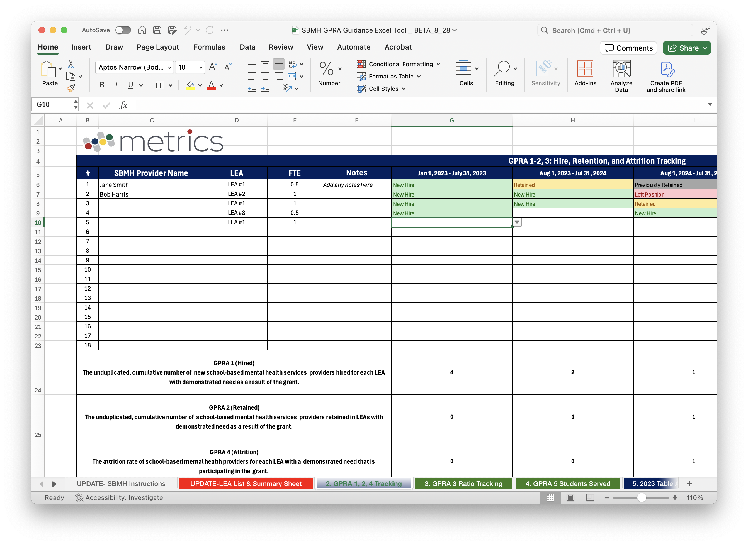
GPRA Guidance Tool

Slide 17
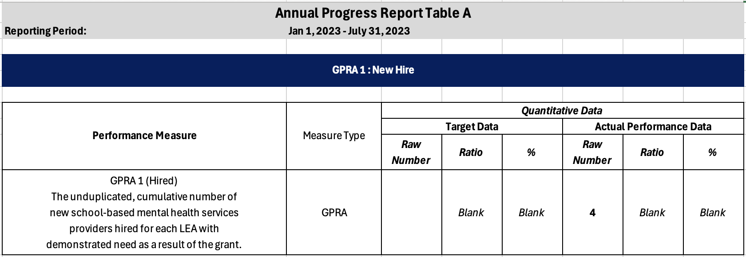
GPRA Guidance Tool

Slide 18

Questions?

Slide 19

Exit Ticket
How did we do?

